Slide 1
Week 4
Advanced Input and Output Devices

Slide 2
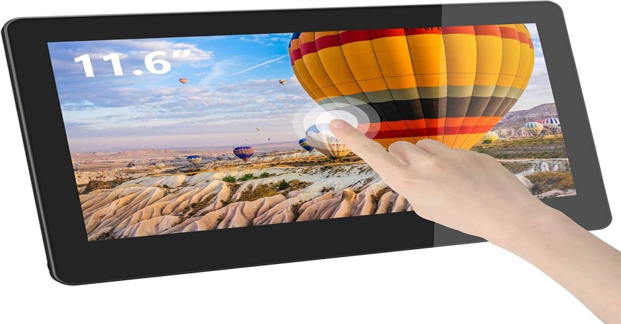
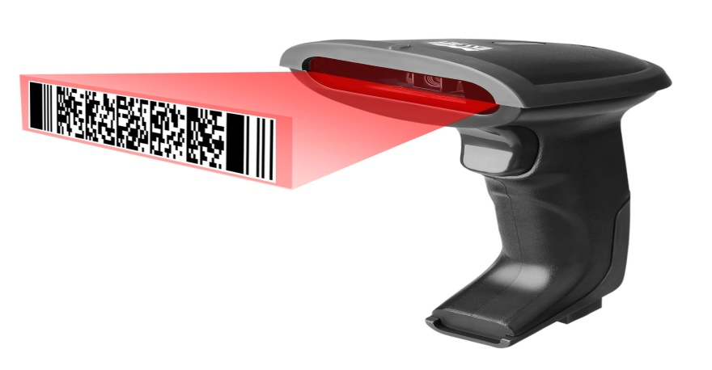
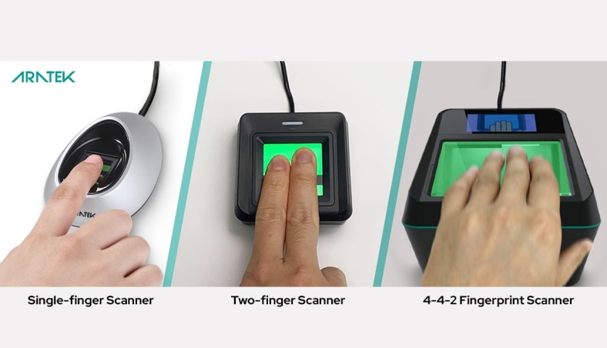
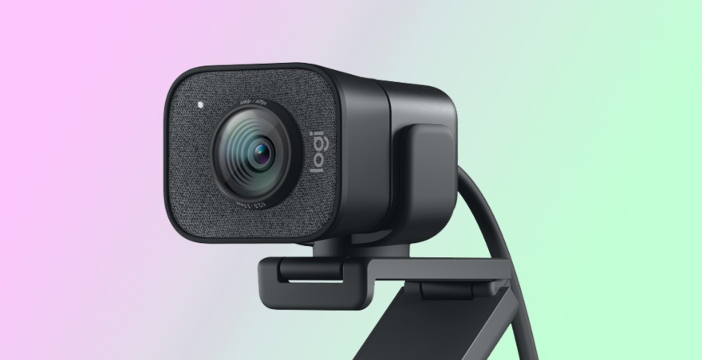
Modern/advanced input devices
Touch Screen
Barcode Reader
Biometric Devices – Fingerprint Scanner
Webcam

Slide 3
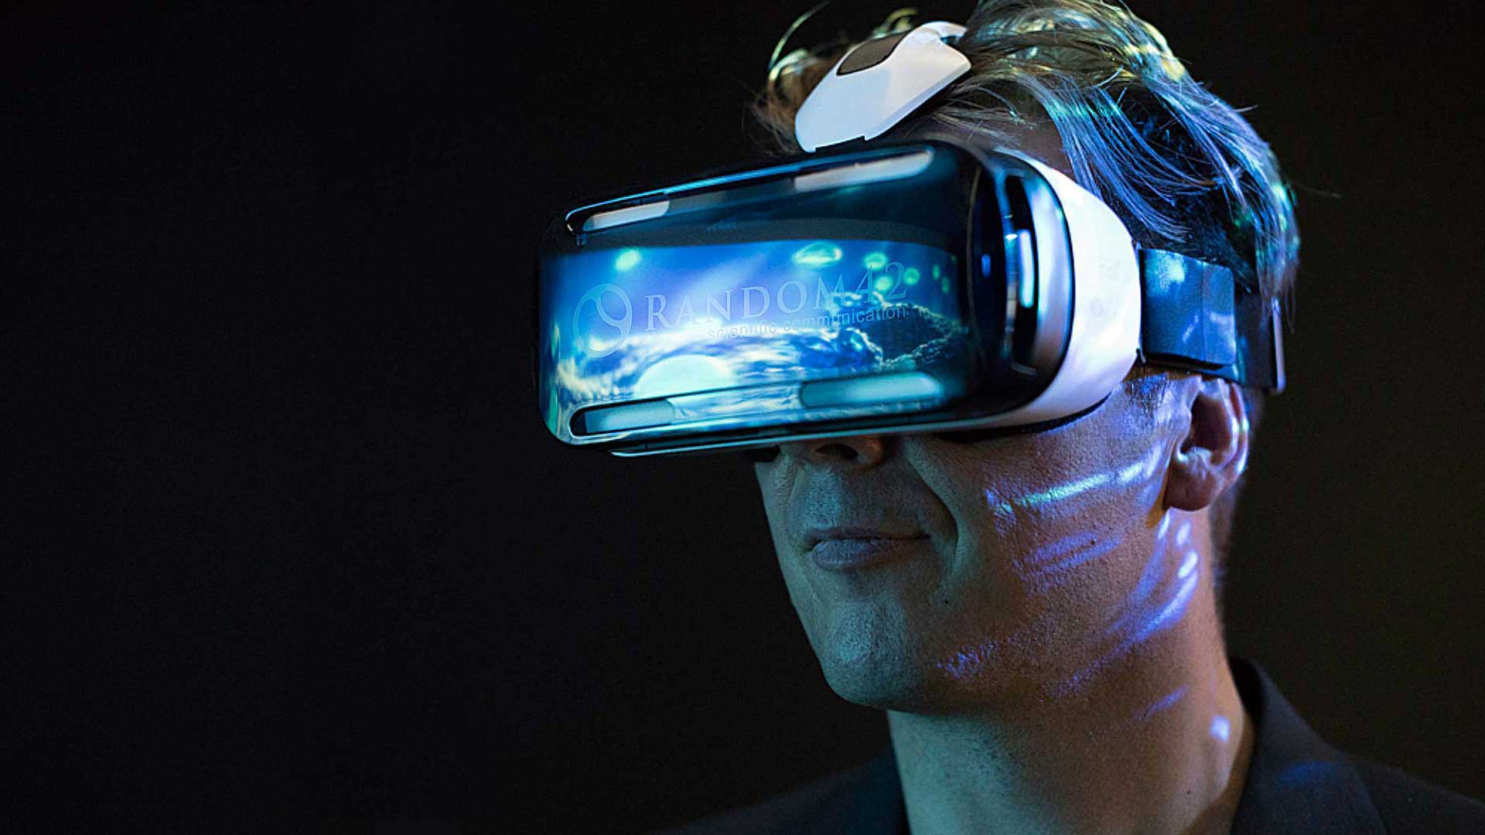
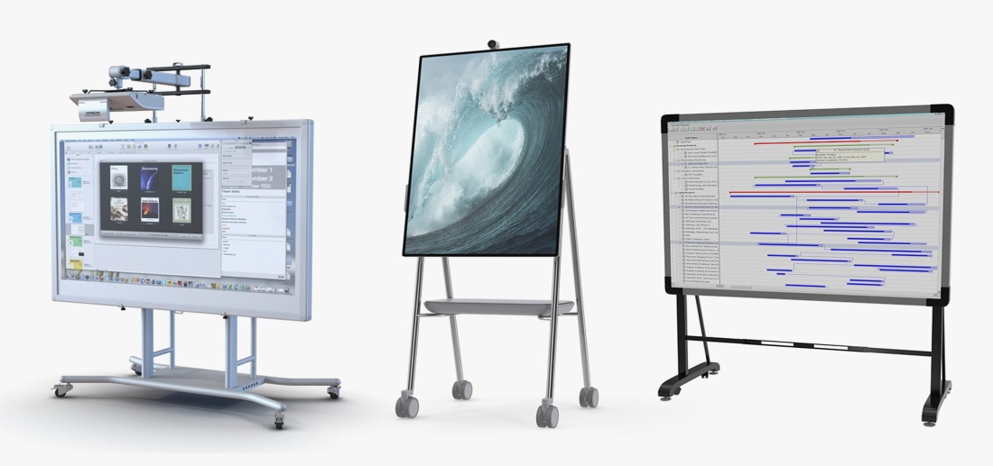
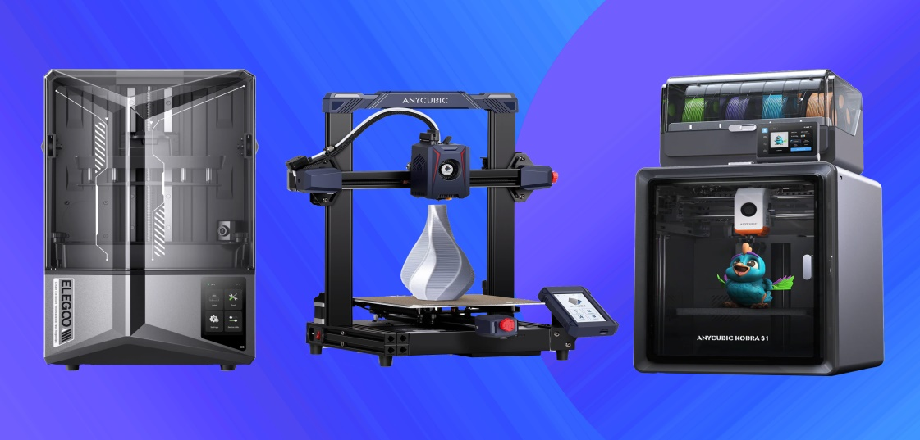
Modern/advanced output devices
Virtual Reality Headsets
Interactive Whiteboards
3D Printer

Slide 4
Advantages and limitations of different devices
Safety and proper handling of devices
Activities
Describe how modern devices are used in everyday life.
Identify advanced input and output devices.
State advantages and disadvantages of selected devices.
Demonstrate proper care and safe use of devices.

